Slide 1
Convolutional Neural Network
Can the network be simplified by considering the properties of images?

Slide 2
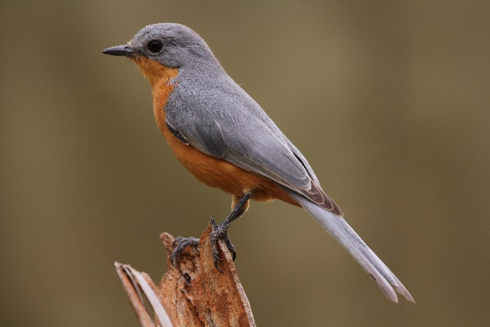
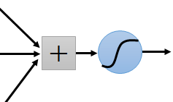
Why CNN for Image
Some patterns are much smaller than the whole image
A neuron does not have to see the whole image to discover the pattern.
Connecting to small region with less parameters
“beak” detector

Slide 3
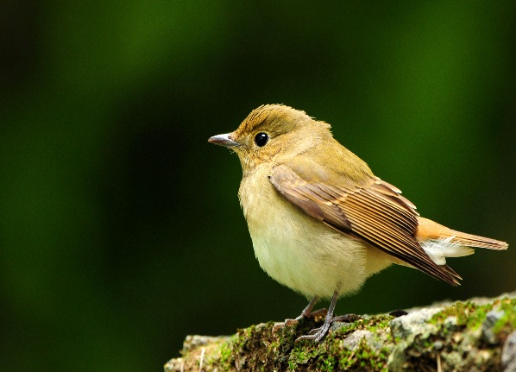
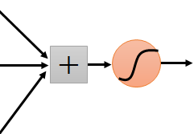
Why CNN for Image
The same patterns appear in different regions.
“upper-left beak” detector
Do almost the same thing
They can use the same set of parameters.
“middle beak” detector

Slide 4
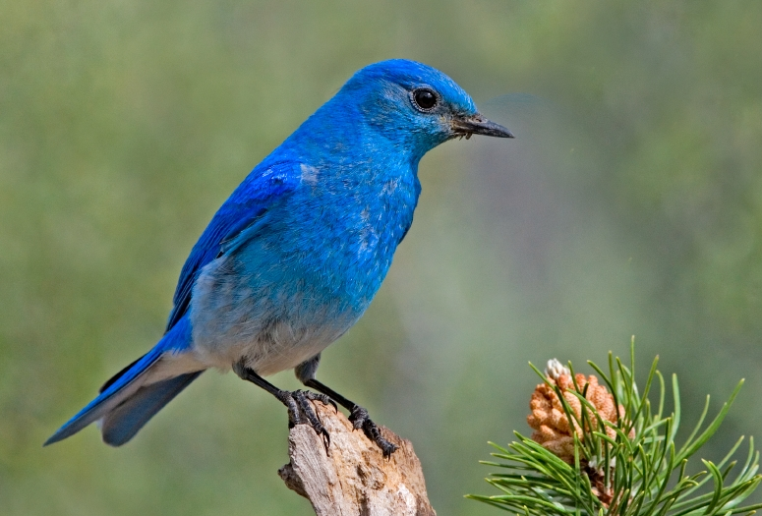

Why CNN for Image
Subsampling the pixels will not change the object
bird
bird
subsampling
We can subsample the pixels to make image smaller
Less parameters for the network to process the image

Slide 5
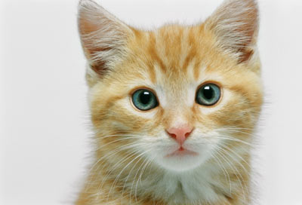
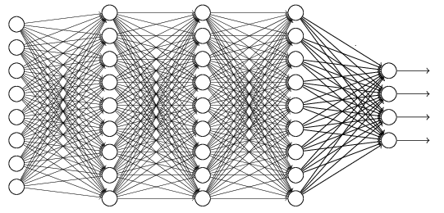
The whole CNN
cat dog ……
Convolution
Max Pooling
Can repeat many times
Fully Connected Feedforward network
Convolution
Max Pooling
Flatten

Slide 6
The whole CNN
Property 1
Some patterns are much smaller than the whole image
Convolution
Property 2
Max Pooling
The same patterns appear in different regions.
Can repeat many times
Property 3
Convolution
Subsampling the pixels will not change the object
Max Pooling
Flatten

Slide 7
The whole CNN
cat dog ……
Convolution
Max Pooling
Can repeat many times
Fully Connected Feedforward network
Convolution
Max Pooling
Flatten

Slide 8
CNN – Convolution
Those are the network parameters to be learned.
1 | -1 | -1
-1 | 1 | -1
-1 | -1 | 1
1 | 0 | 0 | 0 | 0 | 1
0 | 1 | 0 | 0 | 1 | 0
0 | 0 | 1 | 1 | 0 | 0
1 | 0 | 0 | 0 | 1 | 0
0 | 1 | 0 | 0 | 1 | 0
0 | 0 | 1 | 0 | 1 | 0
Filter 1
Matrix
-1 | 1 | -1
-1 | 1 | -1
-1 | 1 | -1
Filter 2
Matrix
……
6 x 6 image
Each filter detects a small pattern (3 x 3).
Property 1

Slide 9
CNN – Convolution
1 | -1 | -1
-1 | 1 | -1
-1 | -1 | 1
Filter 1
stride=1
1 | 0 | 0 | 0 | 0 | 1
0 | 1 | 0 | 0 | 1 | 0
0 | 0 | 1 | 1 | 0 | 0
1 | 0 | 0 | 0 | 1 | 0
0 | 1 | 0 | 0 | 1 | 0
0 | 0 | 1 | 0 | 1 | 0
3
-1
6 x 6 image

Slide 10
CNN – Convolution
1 | -1 | -1
-1 | 1 | -1
-1 | -1 | 1
Filter 1
If stride=2
1 | 0 | 0 | 0 | 0 | 1
0 | 1 | 0 | 0 | 1 | 0
0 | 0 | 1 | 1 | 0 | 0
1 | 0 | 0 | 0 | 1 | 0
0 | 1 | 0 | 0 | 1 | 0
0 | 0 | 1 | 0 | 1 | 0
3
-3
We set stride=1 below
6 x 6 image

Slide 11
CNN – Convolution
1 | -1 | -1
-1 | 1 | -1
-1 | -1 | 1
Filter 1
stride=1
1 | 0 | 0 | 0 | 0 | 1
0 | 1 | 0 | 0 | 1 | 0
0 | 0 | 1 | 1 | 0 | 0
1 | 0 | 0 | 0 | 1 | 0
0 | 1 | 0 | 0 | 1 | 0
0 | 0 | 1 | 0 | 1 | 0
3
-1
-3
-1
-3
1
0
-3
-3
-3
0
1
3
-2
-2
-1
6 x 6 image
Property 2

Slide 12
CNN – Convolution
-1 | 1 | -1
-1 | 1 | -1
-1 | 1 | -1
Filter 2
stride=1
Do the same process for every filter
1 | 0 | 0 | 0 | 0 | 1
0 | 1 | 0 | 0 | 1 | 0
0 | 0 | 1 | 1 | 0 | 0
1 | 0 | 0 | 0 | 1 | 0
0 | 1 | 0 | 0 | 1 | 0
0 | 0 | 1 | 0 | 1 | 0
3
-1
-3
-1
-1
-1
-1
-1
-3
1
0
-3
-1
-1
-2
1
Feature
Map
-3
-3
0
1
-1
-1
-2
1
3
-2
-2
-1
6 x 6 image
-1
0
-4
3
4 x 4 image

Slide 13
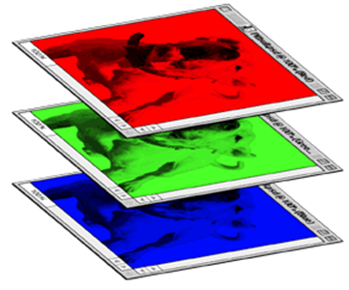
CNN – Colorful image
1 | -1 | -1
-1 | 1 | -1
-1 | -1 | 1
-1 | 1 | -1
-1 | 1 | -1
-1 | 1 | -1
1 | -1 | -1
-1 | 1 | -1
-1 | -1 | 1
-1 | 1 | -1
-1 | 1 | -1
-1 | 1 | -1
1 | -1 | -1
-1 | 1 | -1
-1 | -1 | 1
-1 | 1 | -1
-1 | 1 | -1
-1 | 1 | -1
Filter 1
Filter 2
Colorful image
1 | 0 | 0 | 0 | 0 | 1
0 | 1 | 0 | 0 | 1 | 0
0 | 0 | 1 | 1 | 0 | 0
1 | 0 | 0 | 0 | 1 | 0
0 | 1 | 0 | 0 | 1 | 0
0 | 0 | 1 | 0 | 1 | 0
1 | 0 | 0 | 0 | 0 | 1
0 | 1 | 0 | 0 | 1 | 0
0 | 0 | 1 | 1 | 0 | 0
1 | 0 | 0 | 0 | 1 | 0
0 | 1 | 0 | 0 | 1 | 0
0 | 0 | 1 | 0 | 1 | 0
1 | 0 | 0 | 0 | 0 | 1
0 | 1 | 0 | 0 | 1 | 0
0 | 0 | 1 | 1 | 0 | 0
1 | 0 | 0 | 0 | 1 | 0
0 | 1 | 0 | 0 | 1 | 0
0 | 0 | 1 | 0 | 1 | 0

Slide 14
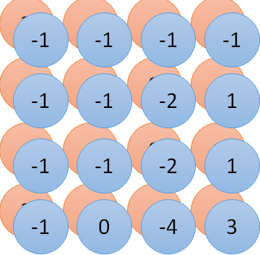
Convolution v.s. Fully Connected
1 | 0 | 0 | 0 | 0 | 1
0 | 1 | 0 | 0 | 1 | 0
0 | 0 | 1 | 1 | 0 | 0
1 | 0 | 0 | 0 | 1 | 0
0 | 1 | 0 | 0 | 1 | 0
0 | 0 | 1 | 0 | 1 | 0
1 | -1 | -1
-1 | 1 | -1
-1 | -1 | 1
-1 | 1 | -1
-1 | 1 | -1
-1 | 1 | -1
convolution
image
1 | 0 | 0 | 0 | 0 | 1
0 | 1 | 0 | 0 | 1 | 0
0 | 0 | 1 | 1 | 0 | 0
1 | 0 | 0 | 0 | 1 | 0
0 | 1 | 0 | 0 | 1 | 0
0 | 0 | 1 | 0 | 1 | 0
Fully-connected
……
……

Slide 15
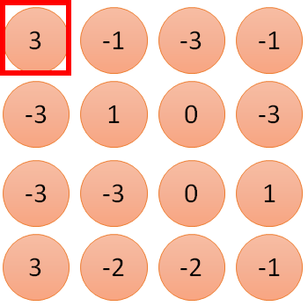
1 | -1 | -1
-1 | 1 | -1
-1 | -1 | 1
1:
1
Filter 1
2:
0
3:
0
3
4:
0
1 | 0 | 0 | 0 | 0 | 1
0 | 1 | 0 | 0 | 1 | 0
0 | 0 | 1 | 1 | 0 | 0
1 | 0 | 0 | 0 | 1 | 0
0 | 1 | 0 | 0 | 1 | 0
0 | 0 | 1 | 0 | 1 | 0
…
7:
0
8:
1
9:
0
10:
0
…
13:
0
6 x 6 image
14:
0
Less parameters!
15:
Only connect to 9 input, not fully connected
1
16:
1
…

Slide 16
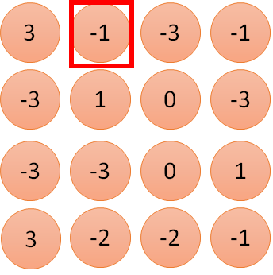
1 | -1 | -1
-1 | 1 | -1
-1 | -1 | 1
1:
1
Filter 1
2:
0
3:
0
3
4:
0
1 | 0 | 0 | 0 | 0 | 1
0 | 1 | 0 | 0 | 1 | 0
0 | 0 | 1 | 1 | 0 | 0
1 | 0 | 0 | 0 | 1 | 0
0 | 1 | 0 | 0 | 1 | 0
0 | 0 | 1 | 0 | 1 | 0
…
7:
0
8:
1
-1
9:
0
10:
0
…
13:
0
6 x 6 image
14:
0
Less parameters!
15:
1
16:
1
Shared weights
Even less parameters!
…

Slide 17
The whole CNN
cat dog ……
Convolution
Max Pooling
Can repeat many times
Fully Connected Feedforward network
Convolution
Max Pooling
Flatten

Slide 18
CNN – Max Pooling
1 | -1 | -1
-1 | 1 | -1
-1 | -1 | 1
-1 | 1 | -1
-1 | 1 | -1
-1 | 1 | -1
Filter 1
Filter 2
3
-1
-3
-1
-1
-1
-1
-1
-3
1
0
-3
-1
-1
-2
1
-3
-3
0
1
-1
-1
-2
1
3
-2
-2
-1
-1
0
-4
3

Slide 19
CNN – Max Pooling
New image
but smaller
1 | 0 | 0 | 0 | 0 | 1
0 | 1 | 0 | 0 | 1 | 0
0 | 0 | 1 | 1 | 0 | 0
1 | 0 | 0 | 0 | 1 | 0
0 | 1 | 0 | 0 | 1 | 0
0 | 0 | 1 | 0 | 1 | 0
Conv
3
0
-1
1
Max
Pooling
3
1
0
3
2 x 2 image
6 x 6 image
Each filter
is a channel

Slide 20
The whole CNN
3
0
-1
1
Convolution
3
1
0
3
Max Pooling
Can repeat many times
A new image
Convolution
Smaller than the original image
The number of the channel is the number of filters
Max Pooling

Slide 21
The whole CNN
cat dog ……
Convolution
Max Pooling
A new image
Fully Connected Feedforward network
Convolution
Max Pooling
A new image
Flatten

Slide 22
Flatten
3
0
1
3
0
-1
1
3
3
1
-1
0
3
Flatten
1
Fully Connected Feedforward network
0
3

Slide 23


CNN in Keras
Only modified the network structure and input format (vector -> 3-D tensor)
input
Convolution
1 | -1 | -1
-1 | 1 | -1
-1 | -1 | 1
-1 | 1 | -1
-1 | 1 | -1
-1 | 1 | -1
There are 25 3x3 filters.
……
Max Pooling
Input_shape = ( 28 , 28 , 1)
28 x 28 pixels
1: black/white, 3: RGB
Convolution
3
-1
3
Max Pooling
-3
1

Slide 24
CNN in Keras
Only modified the network structure and input format (vector -> 3-D tensor)
input
1 x 28 x 28
Convolution
How many parameters for each filter?
9
25 x 26 x 26
Max Pooling
25 x 13 x 13
Convolution
How many parameters for each filter?
225
50 x 11 x 11
Max Pooling
50 x 5 x 5
Notes:
Paras.

Slide 25
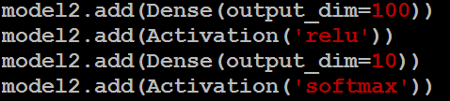
CNN in Keras
Only modified the network structure and input format (vector -> 3-D tensor)
input
1 x 28 x 28
output
Convolution
25 x 26 x 26
Fully Connected Feedforward network
Max Pooling
25 x 13 x 13
Convolution
50 x 11 x 11
Max Pooling
1250
50 x 5 x 5
Flatten

Slide 26
More keras
https://keras.io/activations/ for activations

